Slide 1

Tree-Based Methods
This lecture corresponding to textbook sections 8.1.
Intro to Statistical and Machine Learning
Duo Yu
October 10, 2023

Slide 2
Outline
Basics of decision tree
Regression tree
Classification tree

Slide 3
Tree-based methods
Aim to stratify or segment the predictor space into simple regions
The mean or mode response of the training observation in a region is used for prediction
The approach that summarize the splitting rule for predictor space segment with a tree, called decision tree

Slide 4
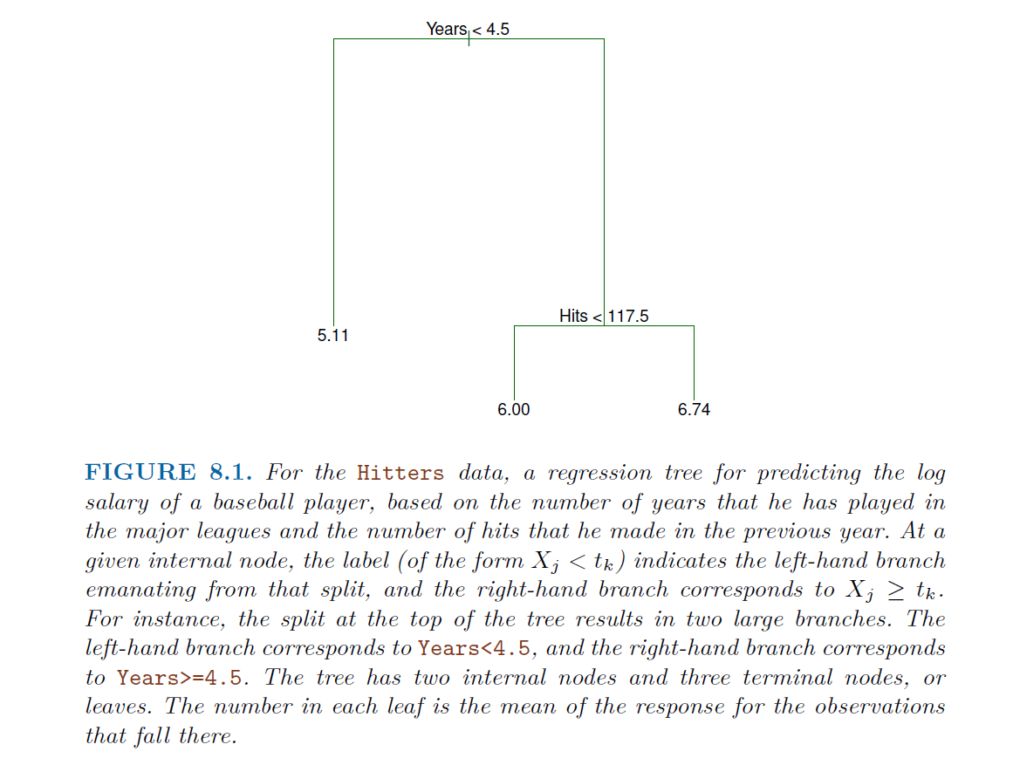
Basics of decision tree
Example problem:
Outcome: baseball player’s log-transformed Salary (measured in thousands of dollars)
Predictors:
Years : # number of played years
Hits : # of hits made in previous year

Slide 5
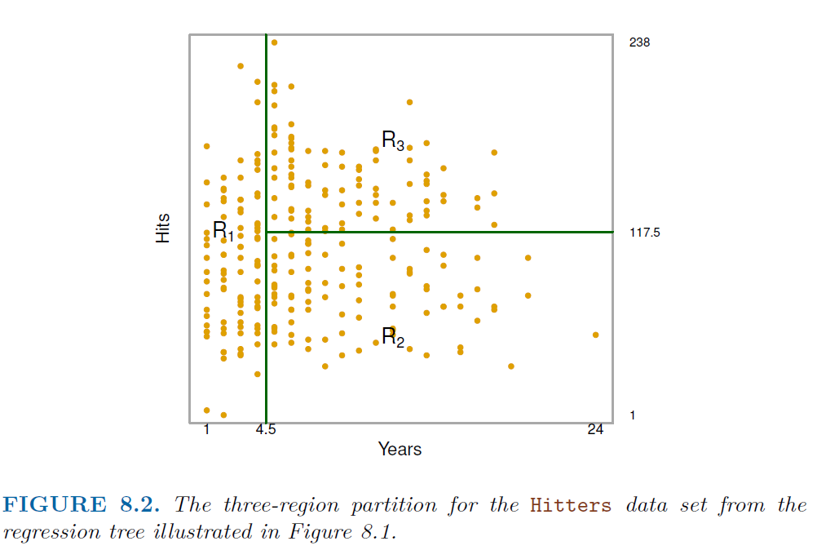
Basics of decision tree: cont.
Overall, the tree stratifies (or segments) the players into three regions of predictor space:
R1 ={X | Years < 4.5},
R2 ={X | Years >=4.5, Hits <117.5}, and
R3 ={X | Years >=4.5, Hits >=117.5}.

Slide 6
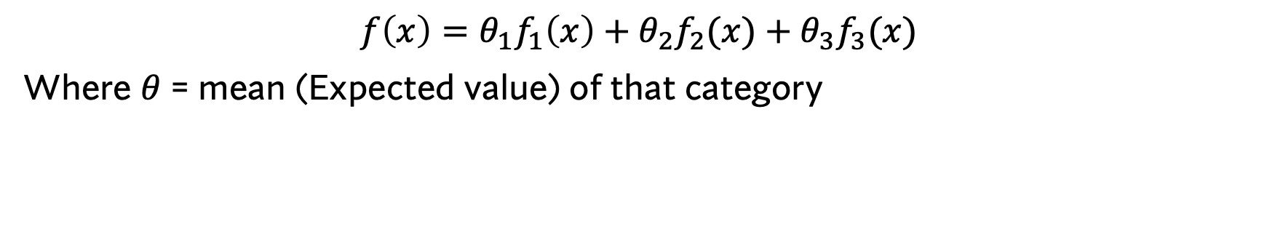
Ex 1: can you write the decision regression rule (function) with basis functions format?
$$f\left(x\right)=θ_{1}f_{1}\left(x\right)+θ_{2}f_{2}(x)+θ_{3}f_{3}(x)$$
Where $θ$ = mean (Expected value) of that category

Slide 7
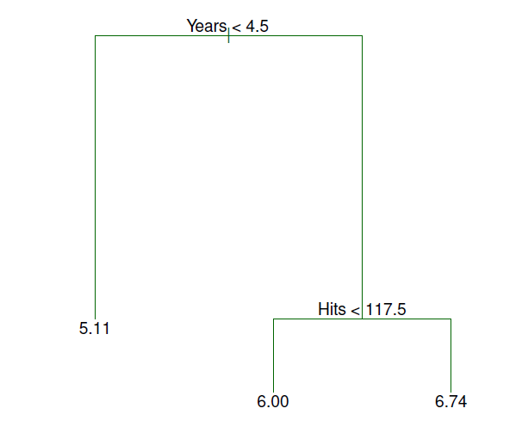
Terminology for trees
In keeping with the tree analogy, the regions R₁, R₂, and R₃ are known as terminal nodes or leaves.
Decision trees are typically drawn upside down, in the sense that the leaves are at the bottom of the tree.
The points along the tree where the predictor space is split are referred to as internal nodes (Years<4.5 and Hits<117.5).
Segment of the trees that connect the nodes called branches.

Slide 8
Interpretation of tree results
Years is the most important factor in determining Salary, and players with less experience earn lower salaries than more experienced players.
Given that a player is less experienced, the number of Hits that he made in the previous year seems to play little role in his Salary.
But among players who have been in the major leagues for five or more years, the number of Hits made in the previous year does affect Salary, and players who made more Hits last year tend to have higher salaries.
Surely an over-simplification, but compared to a regression model, it is easy to display and interpret.

Slide 9
Tree-building process
We divide the predictor space — that is, the set of possible values for X₁, X₂, . . . , X_{p} — into J distinct and non-overlapping regions, R₁, R₂, . . . , R_{J} .
For every observation that falls into the region R_{j} , we make the same prediction, which is simply the mean of the response values for the training observations in R_{j} .

Slide 10

Tree-building process cont.
The regions could have any shape, for simplicity and interpretation purpose, we divide the predictor space into rectangles or boxes.
The goal is to find boxes R₁, . . . , R_{J,} that minimize the RSS, given by
where yˆ_{Rj} is the mean response for the training observations within the jth box.

Slide 11
Ex 2: which one is a valid tree?

Slide 12
Recursive binary splitting
Avoid considering all possible partition of the feature space into J boxes.
Recursive binary splitting takes a top-down, greedy approach.
top-down: begin at the top of the tree, then split the predictor space successively; each split generate two new branches
greedy: the best split is made at that particular step, rather than thinking of the overall tree and picking a split that will lead to a tree in some future step

Slide 13
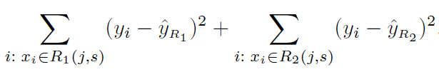
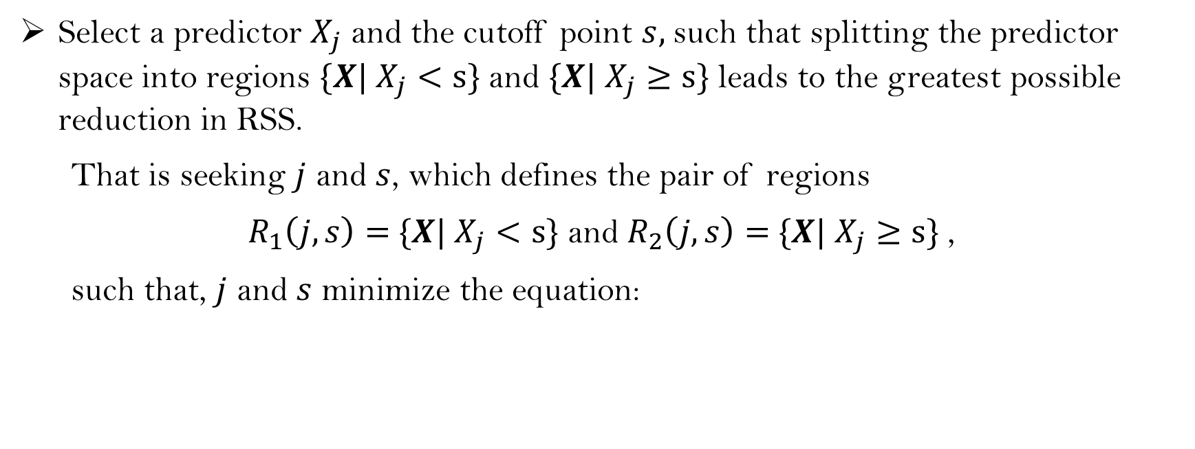
Recursive binary splitting, cont.
Select a predictor $X_{j}$ and the cutoff point $s,$ such that splitting the predictor space into regions $\{X|$ $X_{j}<s\}$ and $\{X|$ $X_{j}≥s\}$ leads to the greatest possible reduction in RSS.
That is seeking $j$ and $s$, which defines the pair of regions
$R_{1}\left(j,s\right)=$ $\{X|$ $X_{j}<s\}$ and $R_{2}\left(j,s\right)=$ $\{X|$ $X_{j}≥s\}$ ,
such that, $j$ and $s$ minimize the equation:

Slide 14
Recursive binary splitting, cont.
Consider the two-previous identified region, repeat the step-1 for each of the region, find the second predictor and corresponding cutoff points, split the predictor space into three regions.
Continue the process until a stopping criterion is reached, usually the stopping criterion can be a pre-specified terminal node size (such as no terminal node has more than 5 observation)

Slide 15
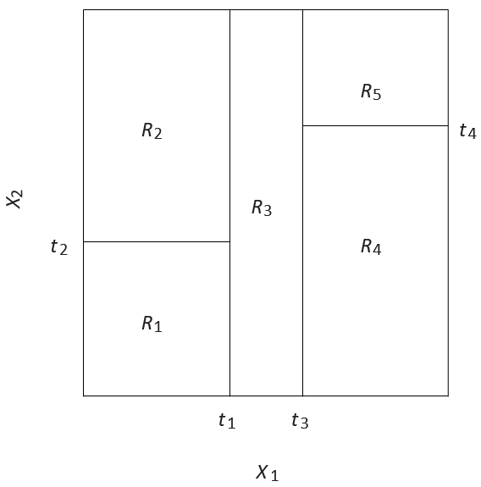
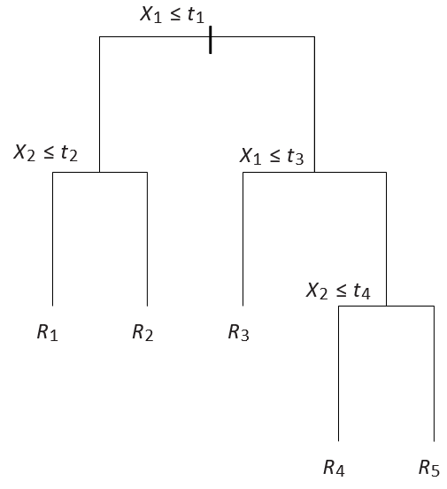
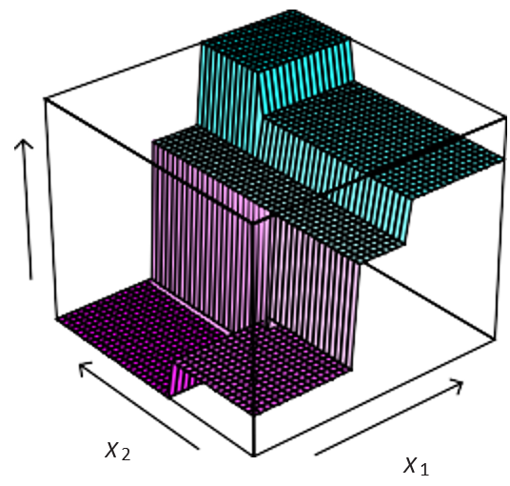
The output of recursive binary splitting on a two-dimensional example
A tree corresponding to the partition in the left figure
A perspective plot of the prediction surface corresponding to that tree

Slide 16
Q 1: Is RSS a good criterion for splitting (or predictor space partition)? When dose RSS reach the minimal value?

Slide 17
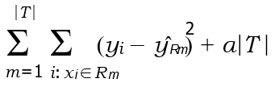
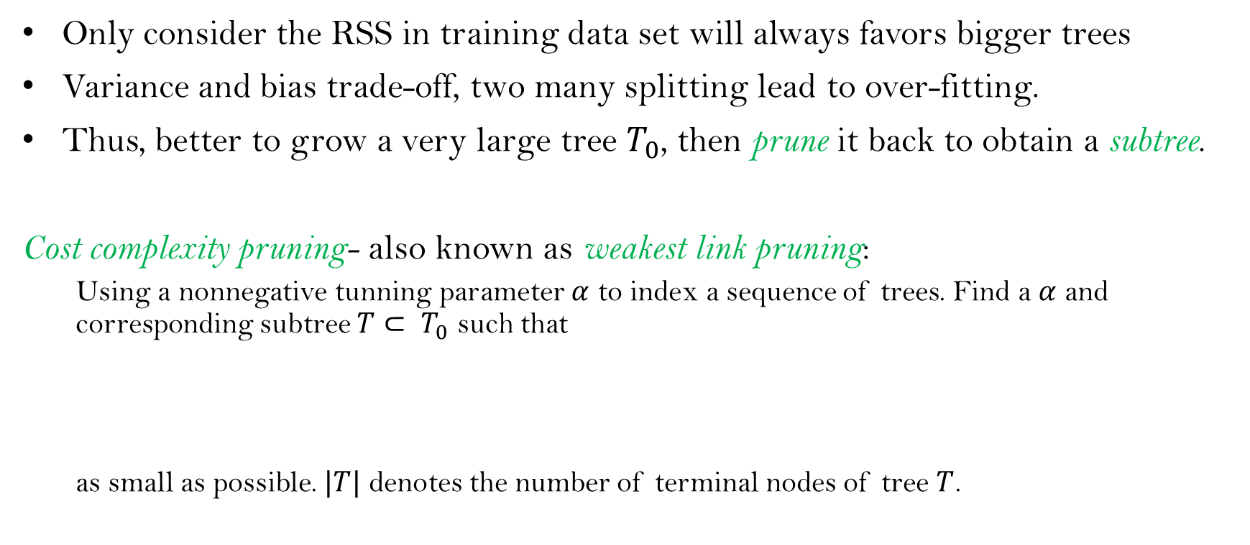
Tree pruning
Only consider the RSS in training data set will always favors bigger trees
Variance and bias trade-off, two many splitting lead to over-fitting.
Thus, better to grow a very large tree $T_{0}$, then prune it back to obtain a subtree.
Cost complexity pruning- also known as weakest link pruning:
Using a nonnegative tunning parameter $α$ to index a sequence of trees. Find a $α$ and corresponding subtree $T⊂ T_{0}$ such that
as small as possible. $|T|$ denotes the number of terminal nodes of tree $T$.

Slide 18
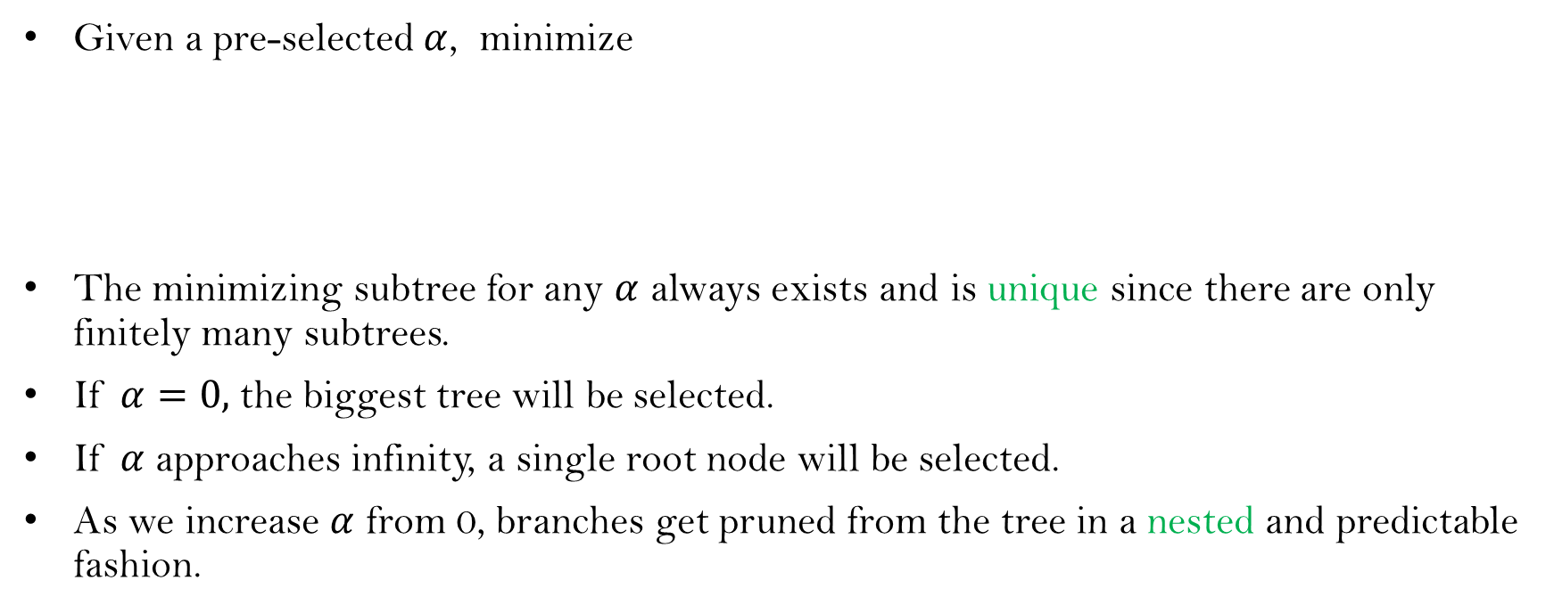
Cost complexity pruning
Given a pre-selected $α$, minimize
The minimizing subtree for any $α$ always exists and is unique since there are only finitely many subtrees.
If $α=0,$ the biggest tree will be selected.
If $α$ approaches infinity, a single root node will be selected.
As we increase $α$ from 0, branches get pruned from the tree in a nested and predictable fashion.

Slide 19
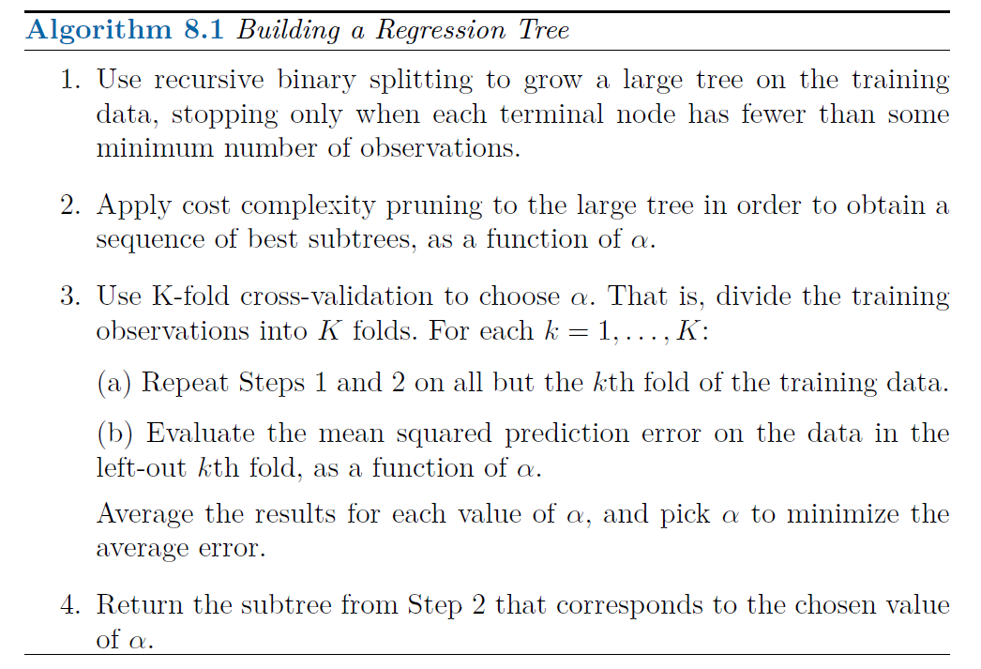

Slide 20
Baseball example
Randomly divide the data in half, yielding 132 observations in the training set and 131 observations in the test set.
Build a large regression tree on the training data
Vary α in to create subtrees with different numbers of terminal nodes
Perform six-fold cross-validation to estimate the cross-validation MSE of the tree as a function of α

Slide 21
Years < 4.5
|
RBI < 60.5
Hits < 117.5
Putou
ts < 82
Years < 3.5
5.394 6.189
Years < 3.5
5.487
4.622 5.183
Walks < 43.5
Walks < 52.5
Runs
80.5
6.015 5.571
6.407
6.549
Years < 6.5
6.459 7.007
7.289

Slide 22

1.0
Training Cross−Validation Test
0.8
Mean Squared Error
$\left|T\right|=3$, reaches the lowest CV error
0.6
0.4
0.2
0.0
2
4
6
8
10
Tree Size

Slide 23
Classification tree
Compare to regression tree building
Outcome is qualitative rather than quantitative.
For prediction, use the most commonly occurring class (mode) of training observations in the region to which it belongs.
Just as regression tree, we use recursive binary splitting to grow a classification tree

Slide 24

Classification tree-cont.
For splitting, RSS is no longer useful
A natural alternative to RSS is the classification error rate; this is simply the fraction of the training observations in that region that do not belong to the most common class:
pˆ_{mk} represents the proportion of training observations in the mth region that are from the kth class. Ideally, we want the m region is pure with only one class, i.e. max(pˆ_{mk} )=1
Other measures: Gini index and Deviance

Slide 25
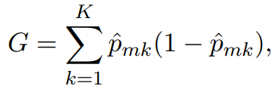
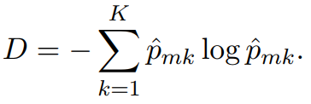
Classification tree-cont.
The Gini index is defined by
a measure of total variance across the K classes.
Gini index takes on a small value if all of the pˆ_{mk} ’s are close to zero or one.
Gini index is referred to as a measure of node purity — a small value indicates that a node contains predominantly observations from a single class.
An alternative to the Gini index is cross-entropy, given by
It turns out that the Gini index and the cross-entropy are very similar numerically.

Slide 26
Example: heart data
These data contain a binary outcome HD for 303 patients who presented with chest pain.
An outcome value of Yes indicates the presence of heart disease based on an angiographic test, while No means no heart disease.
There are 13 predictors including Age, Sex, Chol (a cholesterol measurement), and other heart and lung function measurements.
Cross-validation yields a tree with six terminal nodes. See next figure.

Slide 27
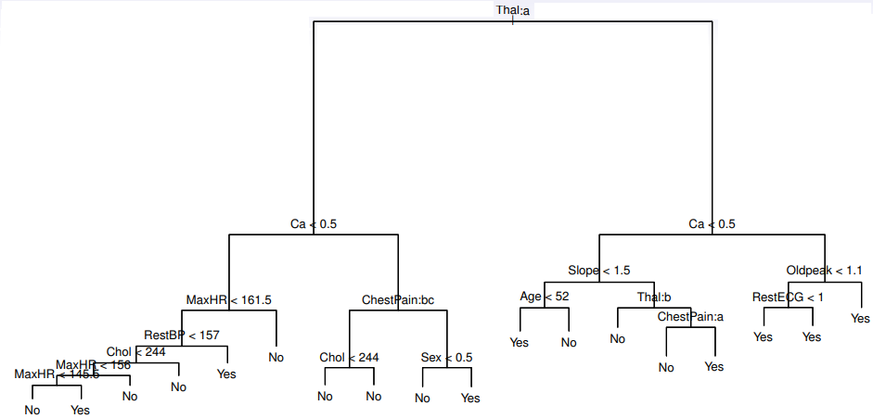
Example: heart data – cont.

Slide 28
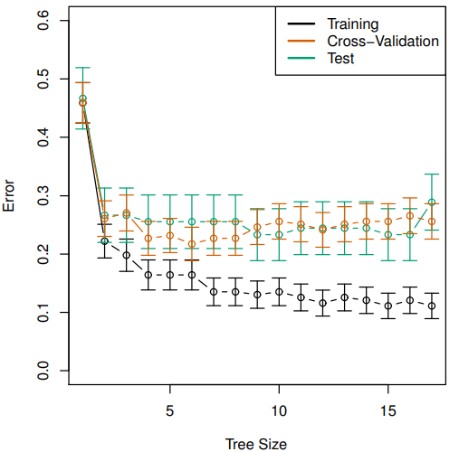
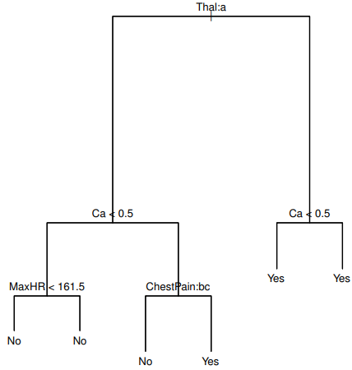
Example: heart data – cont.

Slide 29
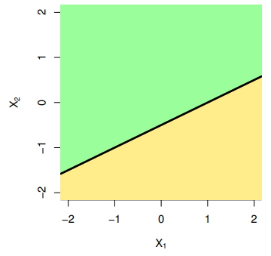
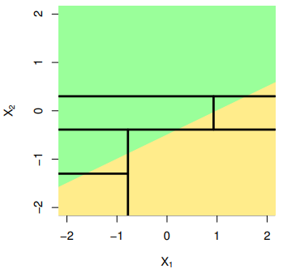
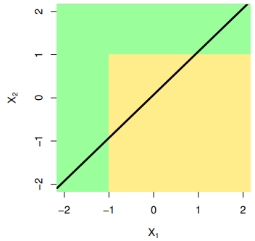
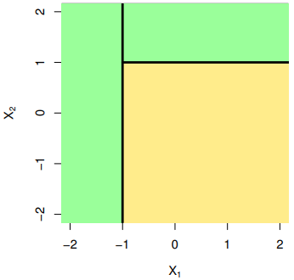
Trees vs. Linear Models
true linear boundary
true non-linear boundary
linear model
tree-based model
linear model
tree-based model

Slide 30
Advantages and Disadvantages of Trees
Trees are very easy to explain to people. In fact, they are even easier to explain than linear regression!
Some people believe that decision trees more closely mirror human decision-making than do the regression and classification approaches seen in previous chapters.
Trees can be displayed graphically, and are easily interpreted even by a non-expert (especially if they are small).
Trees can easily handle qualitative predictors without the need to create dummy variables.
Unfortunately, trees generally do not have the same level of predictive accuracy as some of the other regression and classification approaches seen in this book.
However, by aggregating many decision trees, the predictive performance of trees can be substantially improved. We introduce these concepts next.

